Slide 1
Solution Concentration
Chemistry

Slide 2
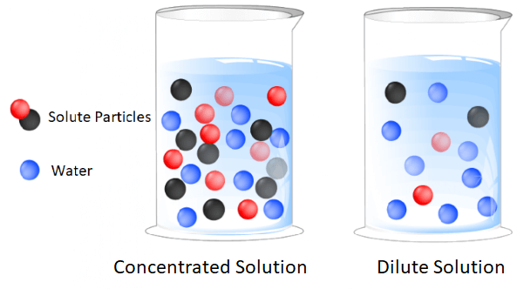
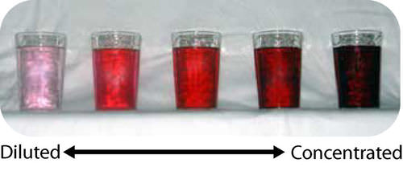
Calculating Solution Concentration
The concentration of a solute in a solution can be expressed with different units, but it is always a ratio of solute to solution.
Concentration α quantity of solute
quantity of solution

Slide 3
Ways to calculate concentration
Type : Grams per Litre
Unit : g.L⁻¹
Formula : c = m ÷ V
c is concentration of solute in grams per Litre (g.L⁻¹)
m is the mass of solute in grams (g)
V is the volume of solution in Litres (L)

Slide 4

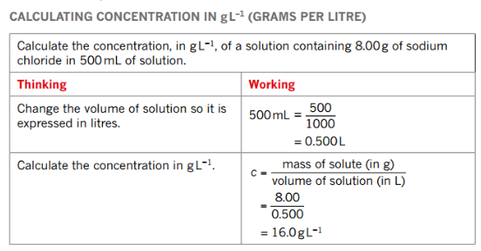
Ways to calculate concentration
Type : Grams per Litre

Slide 5
Ways to calculate concentration
Type : Parts per Million
Unit : ppm
Formula : c = (m_{s} x 10⁶) ÷ m_{t}
or c = m in mg ÷ m in kg
c is concentration of solute in parts per million (ppm)
m_{s} is the mass of solute in grams (g)
m_{t} is the mass of solution (solute + solvent) in grams (g)

Slide 6

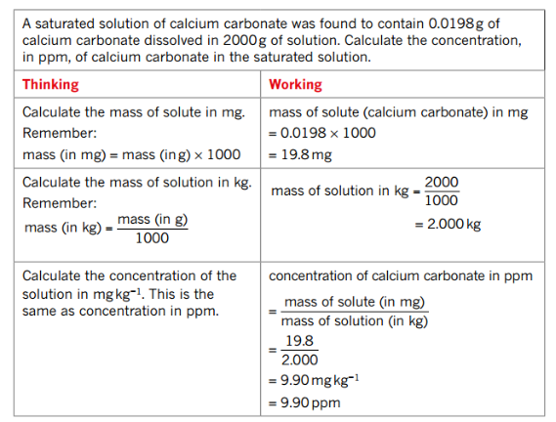
Ways to calculate concentration

Slide 7
Ways to calculate concentration
Type : Percentage composition by mass
Unit : %
Formula : conc (w/w) =
c is concentration of solute in percentage by mass (%)
m_{s} is the mass of solute in grams (g)
m_{t} is the mass of solution (solute + solvent) in grams (g)
Mass solute (g)
x 100
Mass solution (g)

Slide 8
Ways to calculate concentration
Type : Moles per Litre
Unit : mol.L⁻¹
Formula : c = n ÷ V
c is concentration of solute in moles per Litre (mol.L⁻¹)
n is the amount of solute in moles (mol)
V is the volume of solution in Litres (L)
Called molarity (concentration in moles per Litre)

Slide 9
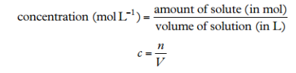
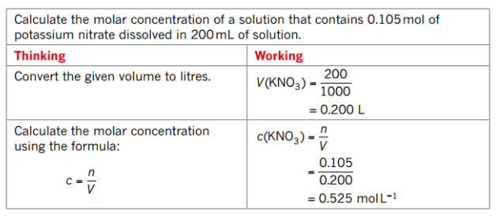
Ways to calculate concentration

Slide 10
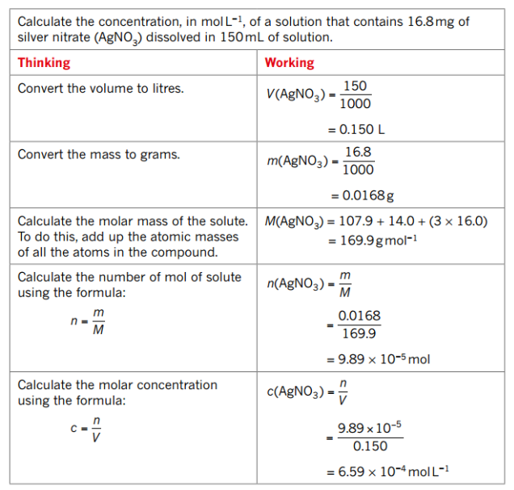

Slide 11
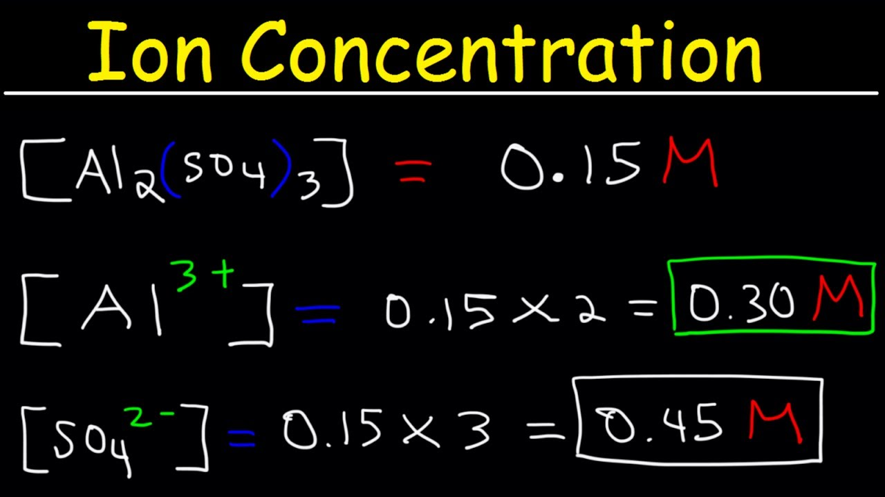
Ion concentrations
Ion concentration = electrolyte concentration multiplied by ion’s subscript (from the chemical formula)

Slide 12
Type Example 1
What is the concentration in mol.L⁻¹ of the solute in a 2.40L solution of NaOH_{(aq)} containing 1.41 mol of NaOH?
c(NaOH) = n/V
= 1.41/2.40
= 0.588 mol.L⁻¹

Slide 13
Type Example 2
What is the concentration of ions present in 2.59 mol.L⁻¹ of Ca(NO₃)₂?
n(Ca²⁺) = n(Ca(NO₃)₂)
Therefore: c(Ca²⁺) = c(Ca(NO₃)₂)
= 2.59 mol.L⁻¹
c(NO₃⁻¹) = 2 x c(Ca(NO₃)₂)
= 2 x 2.59
= 5.18 mol.L⁻¹

